Slide 1
Conflict Resolution
Session 3 – Preparing for Marriage
http://markrobnett.com/MarriagePreparation
Notes:
Last time, we talked about the importance of good communication in our marriages. Without good communications, we cannot grow together in “one-ness” and we cannot talk openly about things that bother us. We must continue to work on improving our communications if we desire to apply today’s lesson – resolving conflict.

Slide 2
Preparing for Marriage – Course Plan
Session 1 – Building Strong Foundations
Session 2 – The Art of Communications
Session 3 – Resolving Conflict
Session 4 – The Impact of Family
Session 5 – Shared Goals and Values
Session 6 – Keeping Love Alive
Notes:
Just to keep you focused on where we’ve been and where we are going…

Slide 3
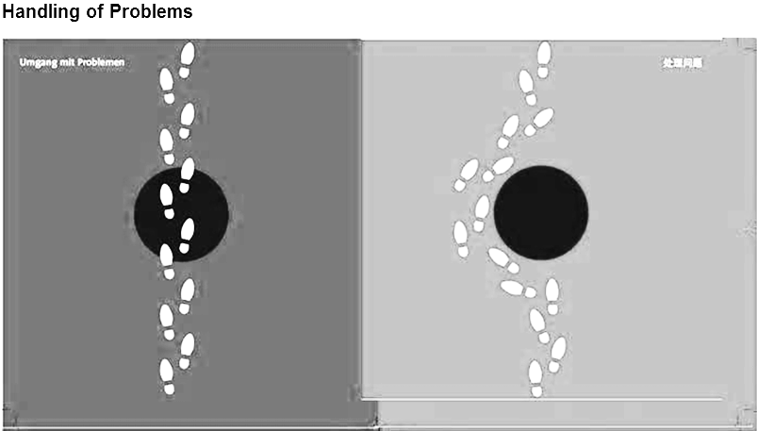
Two Ways to Deal with Conflicts
对应冲突的两种方法
Resolve 解决
Avoid 逃避
It may seem easier (at first) to avoid conflict, but in the long term, unresolved conflicts can ruin a relationship.
避免冲突似乎很容易(在一开始)，但从长远来看，未解决的冲突可能会破坏一段关系。

Slide 4
Why do we have Conflicts?
我们为什么发生冲突？
We are different: genders, backgrounds, personalities, values, opinions.
我们是不同的：性别、背景、个性、价值观、观点。
We are naturally self-centered and don’t like to change (ourselves).
抱怨我们之间的分歧比表达钦佩和感谢容易得多。
As we get older, we may spend less time communicating with each other.
我们在一起的时间越长，我们的交流就越少

Slide 5
一些重要的真理 (Some important truths)
“Do not let the sun go down on your anger.” Ephesians 4:26
“Love keeps no record of wrongs.” 1Corinthians 13:5
Your relationship is more important than any conflict you may encounter.
你的关系比你可能遇到的任何冲突都更重要
Forgiveness is a choice, not a feeling.
宽恕是一种选择，而不是一种感觉。
Notes:
As we approach today’s difficult subject, please know that conflict resolution is not a cultural issue – it is a Biblical imperative. Because Americans are more open and direct, you might think that these ideas don’t apply to people in Eastern cultures. But remember – the Bible is from an Eastern culture…
When it comes to forgiveness, the question is not, “Do we feel like forgiving?” The question is, “Will we forgive?”
Forgiveness is:
Facing the wrong done to us and recognizing the emotions inside.
Choosing not to hold it against our partner.
If we don’t forgive, we’ll be the one imprisoned by the bitterness, resentment, and anger.
Forgiveness is a process – we often need to continue choosing to forgive for the same hurt.

Slide 6
Principles for Handling Conflict
Regularly express appreciation for each other.
Identify and accept differences
Improve your communications
Learn to negotiate
Pray together

Slide 7
1. Expressing Appreciation
Focus on what you like and admire about your partner
Express gratitude for what your partner does
Show appreciation for who your partner is
Make it a daily practice
Exercise 1. Write down 6 things that you appreciate about your partner.
Think about things that they do, who they are, and things that you usually ignore.
When you finish, show each other what you’ve written down.
For example:
  Thank you for working hard to provide for us
  Thank you for making our home comfortable
  I appreciate that you are always truthful
  Thank you for reminding me about important things
  I appreciate your resourcefulness
Notes:
The best way to resolve conflict is to make it a regular habit of expressing appreciation for each other. The more I appreciate my spouse, the easier it will be for me to accept her differences and trust her judgment. And when the time comes to discuss a difference, it will be much easier if she knows how much I appreciate her. If all I ever do is complain at her, conflict resolution will be very difficult.

Slide 8
2. Identify and Accept Differences
Female女性 | Male男性
offer advice and direction | offer solutions
need to be heard and understood | want to fix things
like to connect and talk things out | like to disconnect and think
25000 words per day | 15000 words per day
focus on intimacy and understanding | focus on facts
more emotional | more practical
play it safe | take risks
avoid conflict | engage in conflict
hear and listen better | hear poorly and ignore conversation
enjoy cooperation | enjoy competition
We all have differences in personality, upbringing, and values
Your marriage is a partnership to combine your strengths and support each other’s weaknesses
Don’t expect to change each other
“Accept one another then, just as Christ accepted you…” Romans 15:7
Notes:
These are certainly generalizations, but they show some possible differences between genders.

Slide 9
Exercise 2: Looking at Your Differences
1. Along each line, mark your own preference and your partner's (e.g. M=Mark; S=Susan)
Money | Spend | ________________M__________S________ | Save
2. Share your results and discuss ways that your differences can help strengthen your relationship.
Issue:
Money | Spend | __________________________________ | Save
Vacations | Adventure | __________________________________ | Rest
People | Spend time with others | __________________________________ | Spend time alone
Sleeping | Get up early | __________________________________ | Sleep late
Tidiness | Keep things clean/controlled | __________________________________ | Be relaxed and messy
Disagreements | Discuss and resolve | __________________________________ | Avoid and ignore
Video/TV | Always on | __________________________________ | Never on
Relaxation | Go out | __________________________________ | Stay home
Punctuality | Arrive early | __________________________________ | Often a bit late
Planning | Plan and stick with it | __________________________________ | Be flexible, change easily
Organization | Organized | __________________________________ | Disorganized
Decisions | Slow and cautious | __________________________________ | Quick and spontaneous
Family | See often | __________________________________ | See rarely
Talking | Talkative | __________________________________ | Quiet
Change | Enjoy change | __________________________________ | Resist change
Initiative | Like to lead | __________________________________ | Like to follow

Slide 10
Exercise #3: Rhinos and Hedge Hogs
(From last week’s homework)

Slide 11

Rhinoceros (Rhino)犀牛
When angry, will attack and be very dangerous
生气时，会攻击，而且很危险。

Slide 12

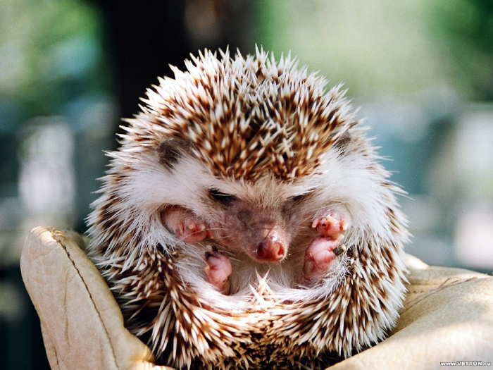
Hedgehog刺猬
When afraid or upset, curls up into self-protective ball
害怕时，蜷缩成自我保护的球状。
Are you a Rhino or a Hedgehog?
What about your partner? Is He/she different than you?
How does this difference (or similarity) affect your ability to resolve conflicts?

Slide 13
3. Improve your communications
Unrealistic Expectations
We must tell each other what frustrates and hurts us (don’t expect “mind-reading”)
Conflict often arises from our different expectations of each other
Must learn about our own and each other’s core values
Requesting change is helpful; demand change is harmful
When we expect our partner to meet all of our needs (e.g. security, significance, self-esteem), we will fail each other and get hurt:
expectations
demands
disappointment
blame
division
Notes:
We’ll talk more about this in the lesson about family background and role expectations.

Slide 14
4. Learn to Negotiate – six steps
Find the best time and place (e.g. before 10:00PM)
Clarify the issue
Discuss the issue rather than attack each other
  Avoid labelling (e.g. “you never” … “you always”)
  Use “I” statements (e.g. “I feel undervalued when…”)
  Listen to each other (e.g. hold a tissue)
Work out possible solutions (make a list if possible)
Decide on the best solution for now and see if it works
Be prepared to re-evaluate if there still seems to be tension over the issue
Notes:
Not too late and never in public
Don’t assume that your spouse sees the issue just like you – clarify and listen to replay

Slide 15
When dealing with conflict:
在处理冲突时：
Focus On: 聚焦在：
Rather than: 而不是：
One issue 一个问题
The problem 问题本身
Behavior 行为
Specifics 具体情况
Expressions of feelings 感情的表达
“I” statements··· “我”开头的陈述
Many issues 多个问题
The person 人的问题
Character 性格
Generalizations 广泛化
Judgment of character品性判断
“You” statements······
你”的陈述

Slide 16
5. Praying Together
“A cord of three strands is not quickly broken.” Eccl 4:12
If one has upset the other, ask forgiveness before praying
Ask each other, “What can I pray for you today?”
Begin with thanksgiving
Pray to God, not each other
The closer we get to God, the closer we get to each other
5-10 minutes daily is better than 1 hour monthly

Slide 17
Principles for Handling Conflict
Regularly express appreciation for each other.
Identify and accept differences
Improve your communications
Learn to negotiate
Pray together

Slide 18
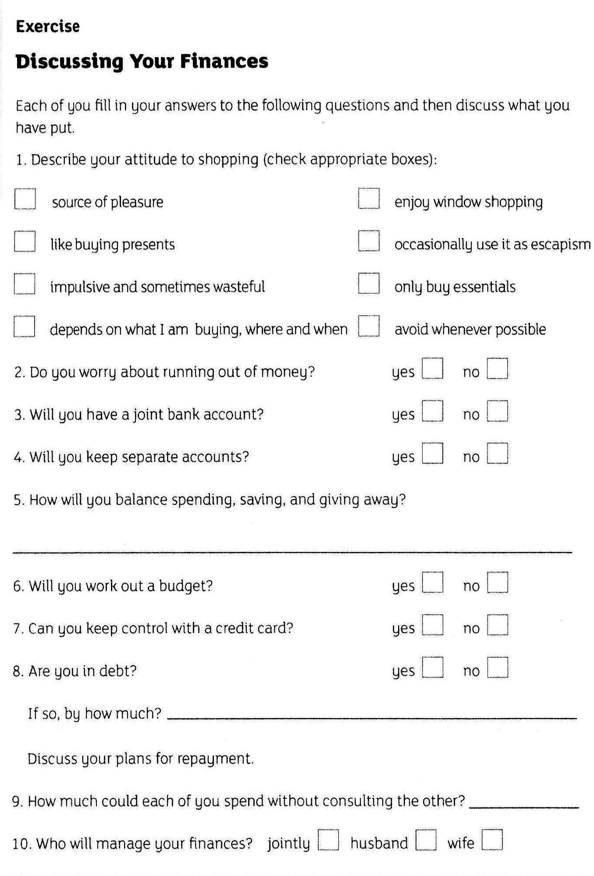
Homework
(remember – your relationship is worth it!)

Slide 19
A more detailed process for conflict resolution
If time permits…

Slide 20
Clarifying Sources of Conflict (step 1)
澄清冲突根源(步骤1)
Did this conflict arise because I did something wrong?这场冲突是因为我做错了什么吗？
  If “yes,” you need to admit it, apologize, and ask forgiveness.
  如果“是”，你需要承认，道歉，并请求原谅
  If “no,” ask the next question…
  如果“否”，问下一个问题…

Slide 21
Clarifying Sources of Conflict (step 2)
澄清冲突根源(步骤2)
Are we having this conflict because of an area of my weakness?我们是否因为我的弱点而发生了这场冲突？
  If “yes,” admit your weakness, clarify expectations, let the other person know that you respect them, and make efforts to grow in those areas.如果“是”，承认你的弱点，澄清你的期望，让别人知道你尊重他们，并努力在这些领域成长
  If “no,” ask the next question…
  如果“否”，问下一个问题…

Slide 22
Clarifying Sources of Conflict (step 3)
澄清冲突根源(步骤3)
Are we having this conflict because of my uniqueness? Do I have some values, expectations, or preferences that they other person might not share?我们是否因为我的独特性而有这种冲突？我是否有其他人可能没有的价值观、期望或偏好？
  If “yes,” clarify your expectations and preferences and be willing to hear those of the other person.
  如果“是”，请澄清你的期望和偏好，并愿意听取其他人的期望和偏好
  If “no,” ask the next question…
  如果“否”，问下一个问题…

Slide 23
Clarifying Sources of Conflict (step 4)
澄清冲突根源(步骤4)
Is there some uniqueness on the other person’s side that I am not understanding (expectations, culture, preferences, or communications style)?在另一方是否有我不理解的独特性(期望、文化、偏好或沟通方式)？
  If “yes,” ask questions and give them an opportunity to clarify their position, thoughts, and feelings.如果“是”，提出问题并给他们机会澄清他们的立场、想法和感受
  If “no,” ask the next question…
  如果“否”，问下一个问题…

Slide 24
Clarifying Sources of Conflict (step 5)
澄清冲突根源(步骤5)
Is there a weakness in the other person’s life that is causing a communications breakdown (and frustration in your relationship)?对方的生活中是否有弱点会导致沟通破裂(以及你们关系中的挫折感)
  Use facts to try and identify this weakness and gently explain how it is causing conflict:利用事实试图识别这一弱点，并温和地解释它是如何造成冲突的：
    “When you did _____, I felt ______.”
    “你这样做的时候，我感觉到了。”
    “When you said ______, I thought _______.”
    “当你说___，我觉得_____.”
  If “no,” ask the next question…
  如果“否”，问下一个问题…

Slide 25
Clarifying Sources of Conflict (step 6)
澄清冲突根源(步骤6)
Did the other person do something wrong? Would they agree that they’ve gone against their moral conscience in some way?对方做错了什么吗？他们会同意他们在某种程度上违背了他们的道德良知吗?
  If “yes” and you value your relationship with the other person, you need to point if out.如果“是”并且你重视你与他人的关系，你需要指出。
  While it may seem easier or safer to ignore the problem, it is actually more honorable to show that you’re willing to help them grow.尽管忽视这个问题似乎更容易或更安全，但表明你愿意帮助他们成长，实际上更值得尊敬
  It also shows that you value your relationship enough to work through difficult situations.
  这也表明，你足够重视你的关系，在困难的情况下能够克服问题。

