Slide 1
Session 5 : The Impact of Family – Past and Present
The Marriage Course
http://ilce.llc/MarriageClasses/Session5-Family/

Slide 2
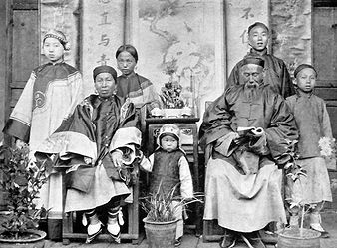
Traditional Chinese Family – 100 years ago
传统的中国家庭——100年前
(Paste a Picture Here)
Who has the most power in this family?这个家庭谁最有权力？
Where are the strongest relationships?最牢固的关系在哪里？
How were the roles of men and women different?
男人和女人的角色有怎样的不同？

Slide 3


中国100年发生了什么？
What has happened in China in the past 100 years?
5081 days
365 days
日本侵华战争 Japanese aggression
1931 - 1945
3518 days
文化大革命
The Great Cultural Revolution
14550 days
人民解放战争
People's Liberation War
1946 - 1949
1966 - 1976
1978 -2018
国民经济发生严重困难 Serious difficulties in national economy
1959 - 1960
改革开放
Reform and opening up
GDP
深圳试办经济特区 Shenzhen try special economic zones
清朝结束
The end of the Qing Dynasty
中华人民共和国成立 The founding of the PRC
加入WTO Join WTO
1912
1912
1949
1980
2001
1912
1921
1930
1939
1948
1957
1966
1975
1984
1993
2002
2011
2021

Slide 4

Modern Chinese Family 现代中国家庭
Who has the most power in this family?这个家庭谁最有权力？
Where are the strongest relationships?最牢固的关系在哪里？
How are the roles of men and women different?
男人和女人的角色有怎样的不同？

Slide 5
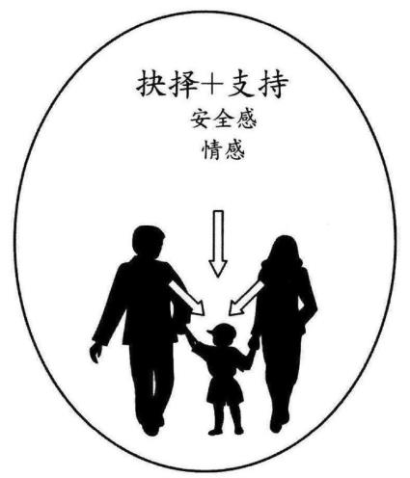
Parents’ Role with Young Children
父母的角色—早年时期
Meet their physical and emotional needs 满足我们的生理和情感需求
Set appropriate boundaries 设置适当的边界
Show unconditional love 显露无条件的爱
Provide good role models 提供良好的榜样

Slide 6
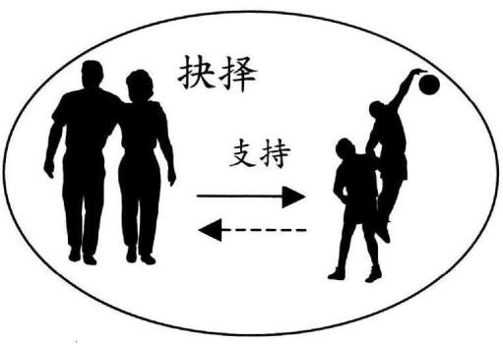
Parents’ Role – Teenage Years
父母的角色—青年时期
Give increasing independence 增加独立
Continue to meet their physical and emotional needs and set appropriate boundaries 继续满足我们的生理和情感需求并设置适当的边界
Teach them to consider parents’ needs and start to give something back
教会我们考虑他们
的需求并开始给予
一些反馈

Slide 7
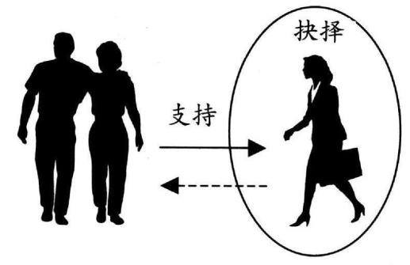
Parents’ Role – Young Adult, Leaving Home
父母的角色—成熟，离开家的时期
Give support and advice 给予支持和建议
Allow independence and encourage them to make their own decisions 允许独立并且支持我们做出自己的决定
Make transition into adult relationships
转变为成年人的关系

Slide 8
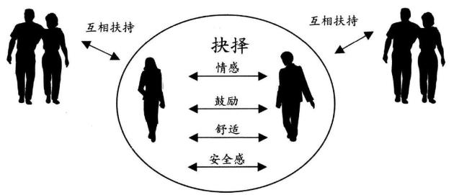
Getting Married – New Family Focus
结婚—新家庭的焦点
Matt 19:5 ‘Therefore a man shall leave his father and his mother and hold fast to his wife, and the two shall become one flesh’
Establish new decision-making structures 建立新的决策结构
Parents relate to “we”, not “I” 父母和“我们”联系，而不仅仅只是“我”
Set appropriate boundaries to build marriage unity while supporting needs of parents
适当的界限来
建立婚姻的统一
同时支持父母的需求

Slide 9
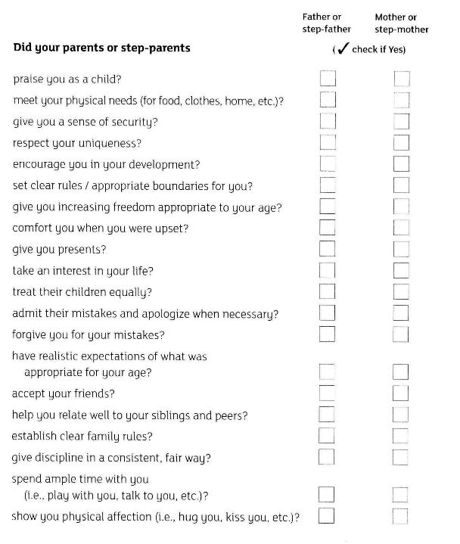
As a child:
Your relationship with your parents (or whoever brought you up)
Take 5 minutes to answer the questions, then share with your spouse and discuss

Slide 10
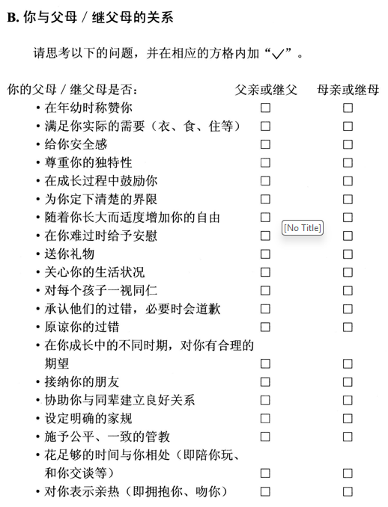
As a child:
Your relationship with your parents (or whoever brought you up)
Take 5 minutes to answer the questions, then share with your spouse and discuss

Slide 11
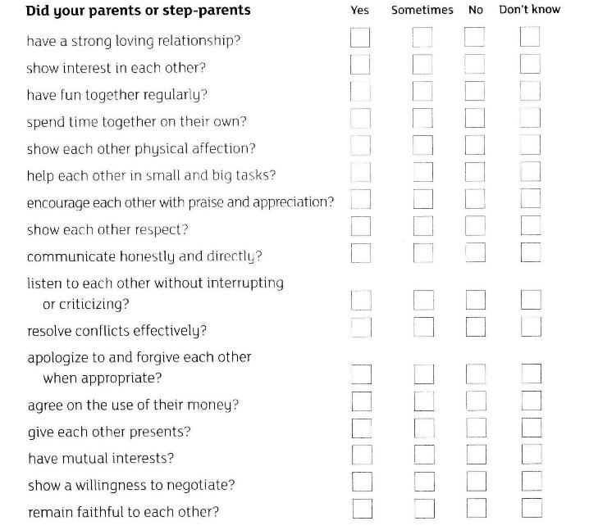
As a Child: the example of your parents
Take 5 minutes to answer the questions, then share with your spouse and discuss

Slide 12
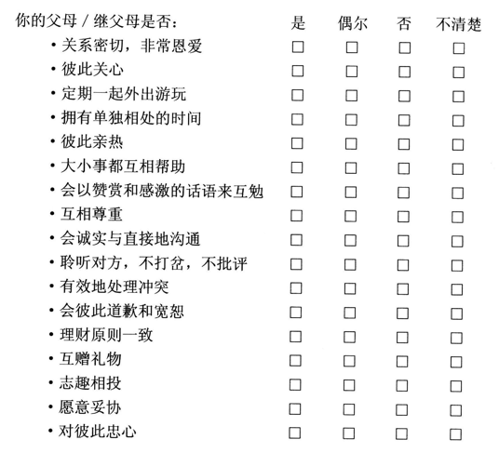
As a Child: the example of your parents
Take 5 minutes to answer the questions, then share with your spouse and discuss

Slide 13
Discuss these questions:
What do you need to be thankful about your upbringing?
Did you have any unmet childhood needs?
How can those unmet needs affect your marriage?
What are some benefits to your marriage / family life through imitating your parents / step-parents / main caregivers?
What are some problems in your marriage / family life through imitating your parents / step-parents / main caregivers?

Slide 14
Expectations of New Family
这周—未来家庭的期望
Expectations are set by experience and are very powerful! 期望是由经验决定的并且是非常强大的
  Decision Making 决策
  Roles and Responsibilities 角色和责任
  Money and Possessions 金钱和财产

Slide 15
Decision Making 决策

Slide 16
Roles and Responsibilities 角色和职责
In your previous family, who was responsible for each of the following tasks? (e.g. 75% : 25%)
In your new family, what do you expect from yourself and your spouse? (e.g. 40% : 60%)

Slide 17
Money and Possessions 金钱和财产

Slide 18
Money and Possessions 金钱和财产
下面每一对陈述中，选择并在其中一条最符合你的家庭成长背景的陈述后打勾。完成后，计算每列中选择的陈述数量
尽量省钱 | 想买就买
担心钱用完了 | 不担心钱的问题
钱只花在必需品上 | 花钱买奢侈品
有时间放松 | 成年人总是在工作
东西坏了就修 | 东西坏了就扔
尽量存钱 | 花钱随意
父母教过如何省钱 | 没学过如何省钱
家庭花销向你解释过 | 家庭花销是迷
总是缺钱 | 从不缺钱
尽量少购物 | 喜欢购物——购物是一种休闲
对钱感到恐惧或迷惑 | 花钱不多想
父母教过如何计划用钱 | 父母管钱

Slide 19
Previous Family and New Family
现在和将来的家庭
What would you like to change?
为什么你想要改变？
What would you like to keep?
什么是你想保留的？
How will you make these changes?
你将如何做出这些改变？
What challenges will you face?
你将面对怎样的挑战？

Slide 20
Some Final Family Thoughts
最后的家庭观念
Your family background has a big influence on your new relationship: 你的家庭背景对你未来的关系有很大的影响
  Positive: Be thankful for the good things in your former family.积极的：感谢那些在你现在家庭中美好的事情
  Negative: No family is perfect. Be honest about the problems and difficult relationships. Decide that you will not repeat them in your new family. 消极的：没有家庭是完美的。坦率对待问题和困难的关系。下决心不让这些问题在你未来的家庭中重演。
  Different: Your family history is not the same as your spouse. Talk about the differences and choose expectations together for your new family. 不同的：你和你配偶的家族史并不一样。讨论这些差异并且为你们的新家庭选择共同的期望。

Slide 21
Homework (very important!)
Have your marriage time each week!
Complete Homework Together

