Slide 1
Session 3 : Conflict Resolution
The Marriage Course
https://ilce.llc/MarriageClasses/Session3-Conflict/

Slide 2
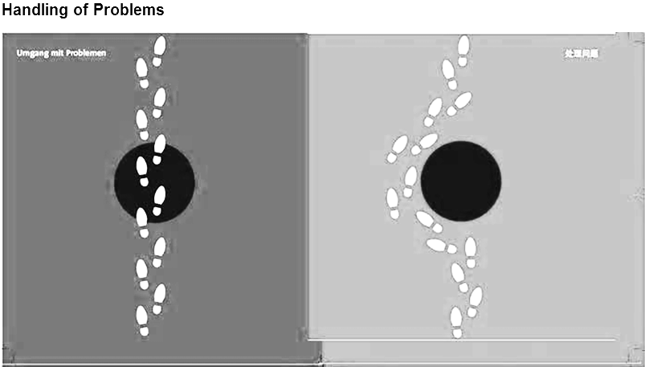
Two Ways to Deal with Conflicts
对应冲突的两种方法
Resolve解决
Avoid逃避

Slide 3
Dealing with Conflicts对应冲突
Conflict is not always bad – we just need to know how to handle it. 冲突并不完全是不好的-我们只需要知道如何处理。
The deeper a relationship gets, the more possible it is that conflicts may happen. 关系越深，冲突就越有可能发生。
It may seem easier (at first) to avoid conflict, but in the long term, unresolved conflicts can ruin a relationship. 避免冲突似乎很容易(在一开始)，但从长远来看，未解决的冲突可能会破坏一段关系。

Slide 4
Why do we have Conflicts?
我们为什么发生冲突？
We are different: genders, backgrounds, personalities, values, opinions. 我们是不同的：性别、背景、个性、价值观、观点。
We are naturally self-centered and don’t like to change (ourselves).
It can be easier to complain about our differences than to say what we like about a person and thank them for what they do. 抱怨我们之间的分歧比表达钦佩和感谢容易得多。
As we get older, we may spend less time communicating with each other. 我们在一起的时间越长，我们的交流就越少
Notes:
We need God’s help to really resolve conflicts and forgive one another.

Slide 5
Principles for Handling Conflict
Regularly express appreciation for each other.
Identify and accept differences
Improve your communications
Learn to negotiate
Pray together
Notes:
By the way, be careful about revealing the faults of your spouse in front of others – save that for private time together.

Slide 6
1. Expressing Appreciation
Focus on what you like and admire about your partner
Express gratitude for what your partner does
Show appreciation for who your partner is
Make it a daily practice
Exercise 1. Write down 3 things that you appreciate about your husband / wife.
Think about things that they do, who they are, and things that you usually ignore.
When you finish, show each other what you’ve written down.
For example:
  Thank you for working hard to provide for us
  Thank you for making our home comfortable
  I appreciate that you are always truthful
  Thank you for reminding me about important things
  I appreciate that don’t waste time and money.

Slide 7
2. Identify and Accept Differences
Men and Women are different! This is God’s good design:
“The LORD God said, “It is not good for the man to be alone. I will make a helper suitable for him.” Genesis 2:18
“…a companion for him who corresponds to him.”
God made your spouse to “complete” you!
She/He will stretch you – and sometimes, frustrate you…
Notes:
“Suitable” (H5048) נֶגֶד neged (neh'-ghed) adj.
1. a front, i.e. part opposite.
2. (specifically) a counterpart, or mate.
3. (usually adverbial, especially with preposition) over against or before.
One of the reasons that people seek same-sex relationships is because they want someone just like themselves (self-centered idolatry)

Slide 8
Typical Gender Differences
Female女性 | Male男性
提供建议和方向; offer advice and direction | 提供解决方法; offer solutions
做出改进; make improvements | 想要修正事情; want to fix things
需要被倾听和理解 need to be heard and understood | 结果关联自我形象 self image tied to results
喜欢连接和交谈 like to connect and talk things out | 喜欢暂时隔离去思考 like to disconnect and think
每天说25000; 25000 words per day | 每天说15000; 15000 words per day
专注亲密关系和理解 focus on intimacy and understanding | 专注事实 focus on facts
更感性; more emotional | 更务实; more practical
安全第一; play it safe | 喜欢冒险; take risks
对情绪感觉灵敏; very aware of emotions | 不知觉情绪; unaware of emotions
避免冲突; avoid conflict | 面对冲突; engage in conflict
倾听更全面 hear and listen better | 选取不中听的内容或是忽视谈话 hear poorly and ignore conversation
享受合作; enjoy cooperation | 享受竞争; enjoy competition

Slide 9
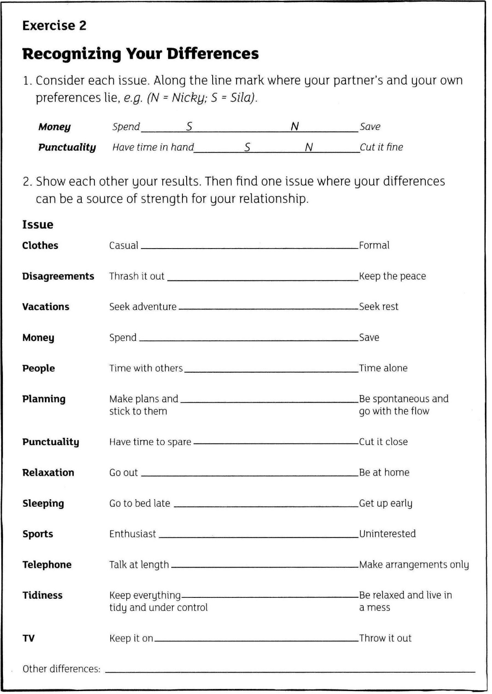
2. Identify and Accept Differences
We all have differences in personality, upbringing, and values
Your marriage is a partnership to combine your strengths and support each other’s weaknesses
Don’t expect to immediately change each other
“Accept one another then, just as Christ accepted you…” Romans 15:7

Slide 10
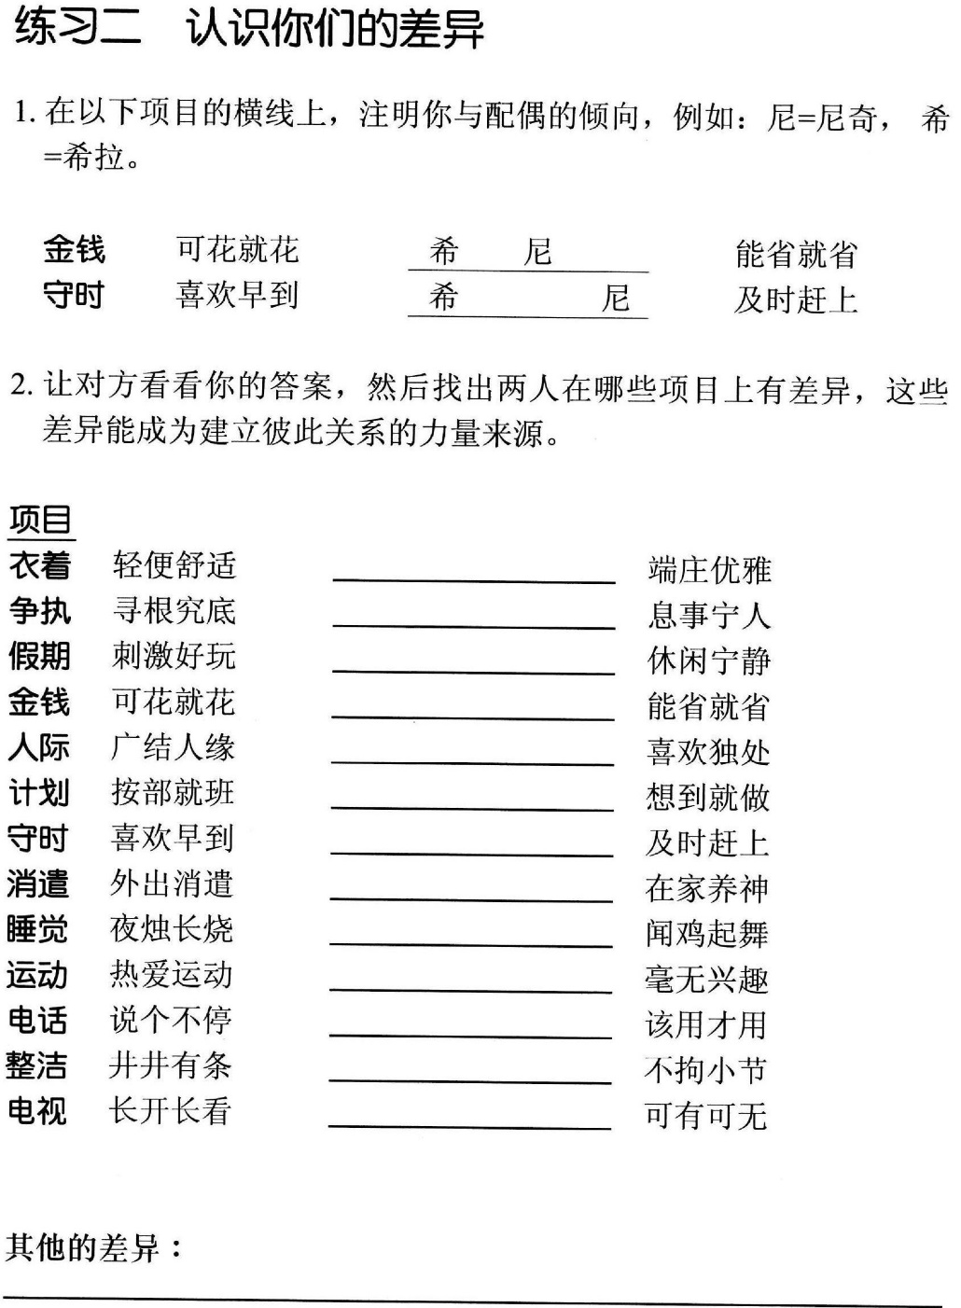

Slide 11
Personal Activity:
Different Ways to Handle Anger
个人活动：愤怒的不同应对方式
(Everyone is different)
每个人都有区别
3
1
2
3
Add up the numbers in column “A” and “B”:把两列数字相加
In each box, put a number to describe you:每个框里填上数字
0 = never从未 1 = rarely偶尔
2 = sometimes有时
3 = often经常
4 =almost always 总是

Slide 14

Rhinoceros (Rhino)犀牛
When angry, will attack
生气时，会攻击

Slide 15

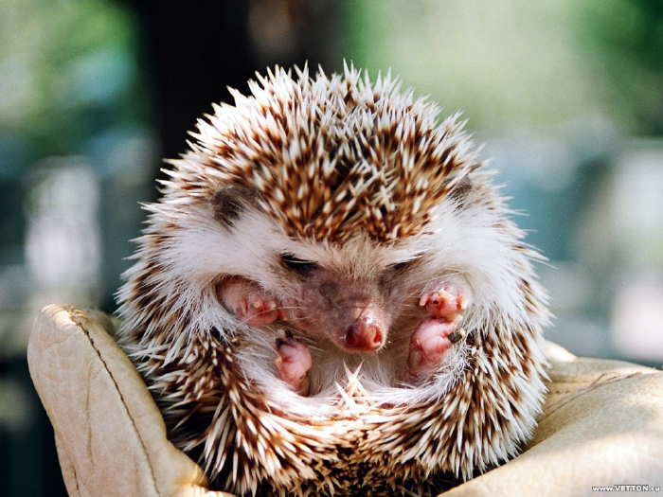
Hedgehog刺猬
When afraid or upset, curls up into self-protective ball
害怕时，蜷缩成自我保护的球状。
Are you a Rhino or a Hedgehog?
What about your spouse? Is He/she different than you?
How does this difference (or similarity) affect your ability to resolve conflicts?

Slide 16
3. Improve your communications
Unrealistic Expectations
We must tell each other what frustrates and hurts us
Much conflict arises from our different expectations of each other
Requesting change is helpful; demand change is harmful
Important to learn about our own and each other’s values
When we expect our partner to meet all of our needs (e.g. security, significance, self-esteem), we will fail each other and get hurt:
expectations
demands
disappointment
blame
division

Slide 17
When dealing with conflict:
在处理冲突时：
Focus On:聚焦在：
Rather than:而不是：
One issue 一个问题
The problem 问题本身
Behavior 行为
Specifics 具体情况
“I feel” statements “我”开头的陈述
Many issues 多个问题
The person 人的问题
Character 性格
Generalizations 广泛化
“You” statements 你”的陈述

Slide 18
4. Learn to Negotiate – six steps
Find the best time and place (e.g. before 10:00PM)
Clarify the issue
Discuss the issue rather than attack each other
  Avoid labelling (e.g. “you never” … “you always”)
  Use “I feel” statements (e.g. “I feel undervalued when…”)
  Listen to each other (e.g. hold a tissue when talking)
Work out possible solutions (make a list if possible)
Agree on the best solution for now and see if it works
Be prepared to re-evaluate if there still seems to be conflict over the issue
Notes:
Not too late and never in public
Don’t assume that your spouse sees the issue just like you – clarify and listen to replay

Slide 19
5. Praying Together
“A cord of three strands is not quickly broken.” Eccl 4:12
If one has upset the other, ask forgiveness before praying
Ask each other, “What can I pray for you today?”
Begin with thanksgiving
Pray to God, not each other
The closer we get to God, the closer we get to each other
5-10 minutes daily is better than 1 hour monthly

Slide 20
一些重要的真理 (Some important truths)
Your relationship is more important than any conflict you may encounter. 你的关系比你可能遇到的任何冲突都更重要
Forgiveness is a choice, not a feeling. 宽恕是一种选择，而不是一种感觉。
“Do not let the sun go down on your anger.” Ephesians 4:26 不要让希望因你的愤怒而退却
“Love keeps no record of wrongs.” 1 Corinthians 13:5 爱不记录错误
“Do all things without grumbling or disputing, that you may be blameless and innocent, children of God without blemish in the midst of a crooked and twisted generation, among whom you shine as lights in the world,” Philippians 2:14,15 无论作什么，都不要发怨言、起争论， 好使你们无可指摘、纯洁无邪，在这弯曲乖谬的世代中，作 神没有瑕疵的儿女；你们要在世上发光，好像天上的光体一样，
Notes:
The question is not, “Do we feel like forgiving?” The question is, “Will we forgive?”
Forgiveness is:
Facing the wrong done to us and recognizing the emotions inside.
Choosing not to hold it against our partner.
If we don’t forgive, we’ll be the one imprisoned by the bitterness, resentment, and anger.
Forgiveness is a process – we often need to continue choosing to forgive for the same hurt.

Slide 21
Principles for Handling Conflict
Regularly express appreciation for each other.
Identify and accept differences
Improve your communications
Learn to negotiate
Pray together

Slide 22
Homework
(remember – your marriage is worth it!)
Remember – Marriage Time!
Do Homework:
  Focusing on the Issue
  Matching our Strides

Slide 23
Additional ideas about anger and conflict resolution
If time permits…

Slide 24
没解决的愤怒的影响
The Effects of Unresolved Anger
Depression: feel alone and withdrawn.抑郁：感到孤独和孤僻
Anxiety: Fear.焦虑：恐惧
Violence or Abuse:暴力或虐待
Addiction: abusing drugs, food, alcohol, the Internet滥用毒品、食物、酒精、互联网

Slide 25
没解决的愤怒的影响
Physical Effects of Suppressed Anger
Fatigue/ Chronic pain: Knowingly and unknowingly you clench your fists, grind your teeth, and tense your shoulders. 疲劳/慢性疼痛：在不知不觉中，你握紧拳头，磨牙，绷紧肩膀。
Digestive problems: Gastrointestinal distress is a common symptom of a stressed mind and emotional state. 消化问题：胃肠不畅是一种常见的精神压力和情绪状态的症状。
High blood pressure/ Cardiac disease: influence on heart and vascular health. Studies show that the risk of coronary artery disease is doubled, and heart attack. 高血压/心脏病：冠心病和心脏病发作的风险增加了一倍
Headaches头痛

Slide 26
Five Reactions to Conflict
对冲突的五种反应
Assertiveness (focus on my needs and desired outcomes) 自信(专注于我的需求和期望的结果)
I win, you lose.
我赢，你输
Mutual Agreement相互协定
Compromise
和解
Withdrawal
倒退
Yielding
屈从
Cooperativeness (Focus on others’ needs and relationships)
合作(注重他人的需要和关系)
“Thomas-Kilmann Conflict Modes”
Notes:
Five reactions to Conflict
I win, you lose – this is the person who thinks they are always right.
Yielding – this person has a definite opinion, but does not voice it as strongly as it is felt. A yielder would rather let someone else have their way than endure an argument.
Withdrawal – this person hates being in arguments.
Compromise – this person sees that they cannot expect to get everything the way that they want it, so they are willing to settle for something less.
Mutual Agreement – the best result!

Slide 27
Clarifying Sources of Conflict (step 1)
澄清冲突根源(步骤1)
Did this conflict arise because I did something wrong?这场冲突是因为我做错了什么吗？
  If “yes,” you need to admit it, apologize, and ask forgiveness.
  如果“是”，你需要承认，道歉，并请求原谅
  If “no,” ask the next question…
  如果“否”，问下一个问题…

Slide 28
Clarifying Sources of Conflict (step 2)
澄清冲突根源(步骤2)
Are we having this conflict because of an area of my weakness?我们是否因为我的弱点而发生了这场冲突？
  If “yes,” admit your weakness, clarify expectations, let the other person know that you respect them, and make efforts to grow in those areas.如果“是”，承认你的弱点，澄清你的期望，让别人知道你尊重他们，并努力在这些领域成长
  If “no,” ask the next question…
  如果“否”，问下一个问题…

Slide 29
Clarifying Sources of Conflict (step 3)
澄清冲突根源(步骤3)
Are we having this conflict because of my uniqueness? Do I have some values, expectations, or preferences that they other person might not share?我们是否因为我的独特性而有这种冲突？我是否有其他人可能没有的价值观、期望或偏好？
  If “yes,” clarify your expectations and preferences and be willing to hear those of the other person.
  如果“是”，请澄清你的期望和偏好，并愿意听取其他人的期望和偏好
  If “no,” ask the next question…
  如果“否”，问下一个问题…

Slide 30
Clarifying Sources of Conflict (step 4)
澄清冲突根源(步骤4)
Is there some uniqueness on the other person’s side that I am not understanding (expectations, culture, preferences, or communications style)?在另一方是否有我不理解的独特性(期望、文化、偏好或沟通方式)？
  If “yes,” ask questions and give them an opportunity to clarify their position, thoughts, and feelings.如果“是”，提出问题并给他们机会澄清他们的立场、想法和感受
  If “no,” ask the next question…
  如果“否”，问下一个问题…

Slide 31
Clarifying Sources of Conflict (step 5)
澄清冲突根源(步骤5)
Is there a weakness in the other person’s life that is causing a communications breakdown (and frustration in your relationship)?对方的生活中是否有弱点会导致沟通破裂(以及你们关系中的挫折感)
  Use facts to try and identify this weakness and gently explain how it is causing conflict:利用事实试图识别这一弱点，并温和地解释它是如何造成冲突的：
    “When you did _____, I felt ______.”
    “你这样做的时候，我感觉到了。”
    “When you said ______, I thought _______.”
    “当你说___，我觉得_____.”
  If “no,” ask the next question…
  如果“否”，问下一个问题…

Slide 32
Clarifying Sources of Conflict (step 6)
澄清冲突根源(步骤6)
Did the other person do something wrong? Would they agree that they’ve gone against their moral conscience in some way?对方做错了什么吗？他们会同意他们在某种程度上违背了他们的道德良知吗?
  If “yes” and you value your relationship with the other person, you need to point if out.如果“是”并且你重视你与他人的关系，你需要指出。
  While it may seem easier or safer to ignore the problem, it is actually more honorable to show that you’re willing to help them grow.尽管忽视这个问题似乎更容易或更安全，但表明你愿意帮助他们成长，实际上更值得尊敬
  It also shows that you value your relationship enough to work through difficult situations.
  这也表明，你足够重视你的关系，在困难的情况下能够克服问题。

